Slide 1


Slide 2


University Course Timetabling System
Automated Scheduling Solution
KAY A UCTTP Efficient Solution

Slide 3

CONTENT
01
02
University Course Timetabling System
Problem Complexity Analysis
03
04
System Architecture Components
Data Structure Design
05
06
Genetic Algorithm Implementation
System Benefits

Slide 4
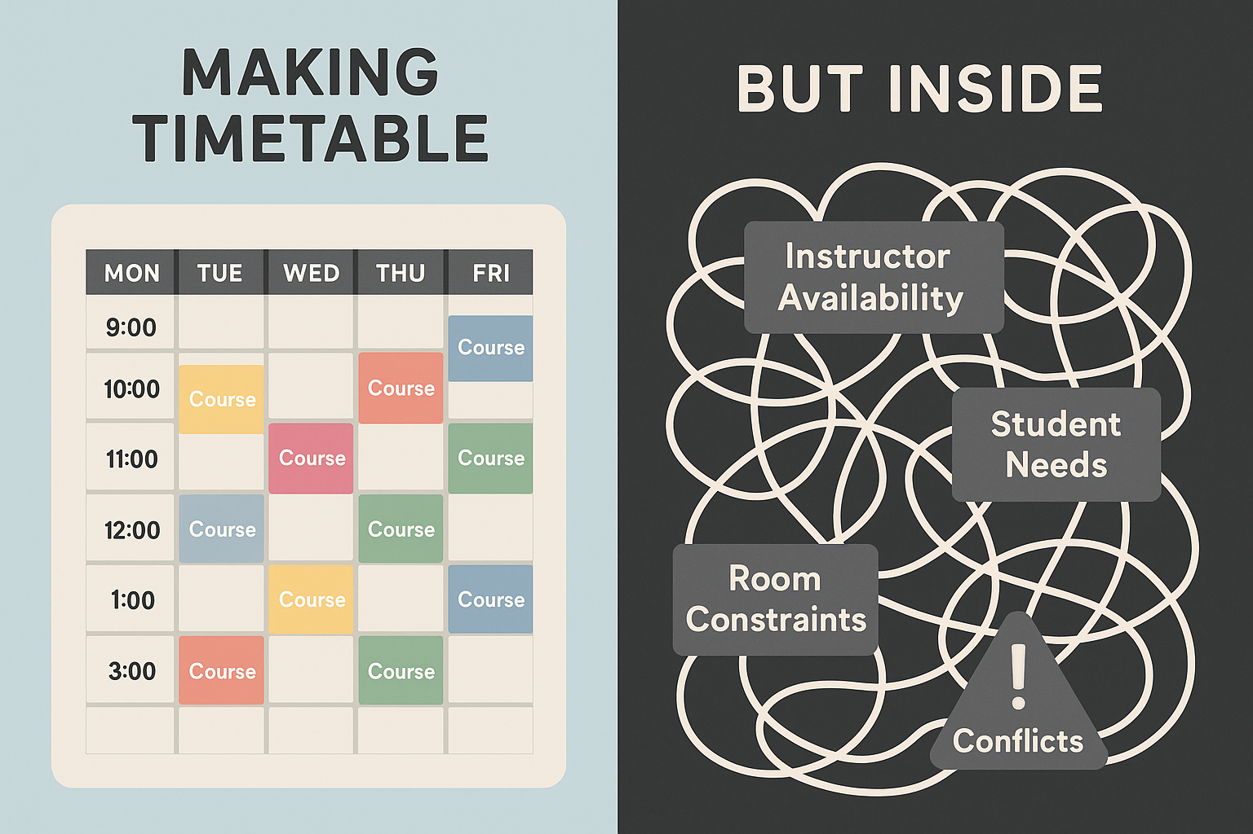
The problem
University timetables looks simple on the outside, but in reality, it is a massive complex optimization problem.

Slide 5

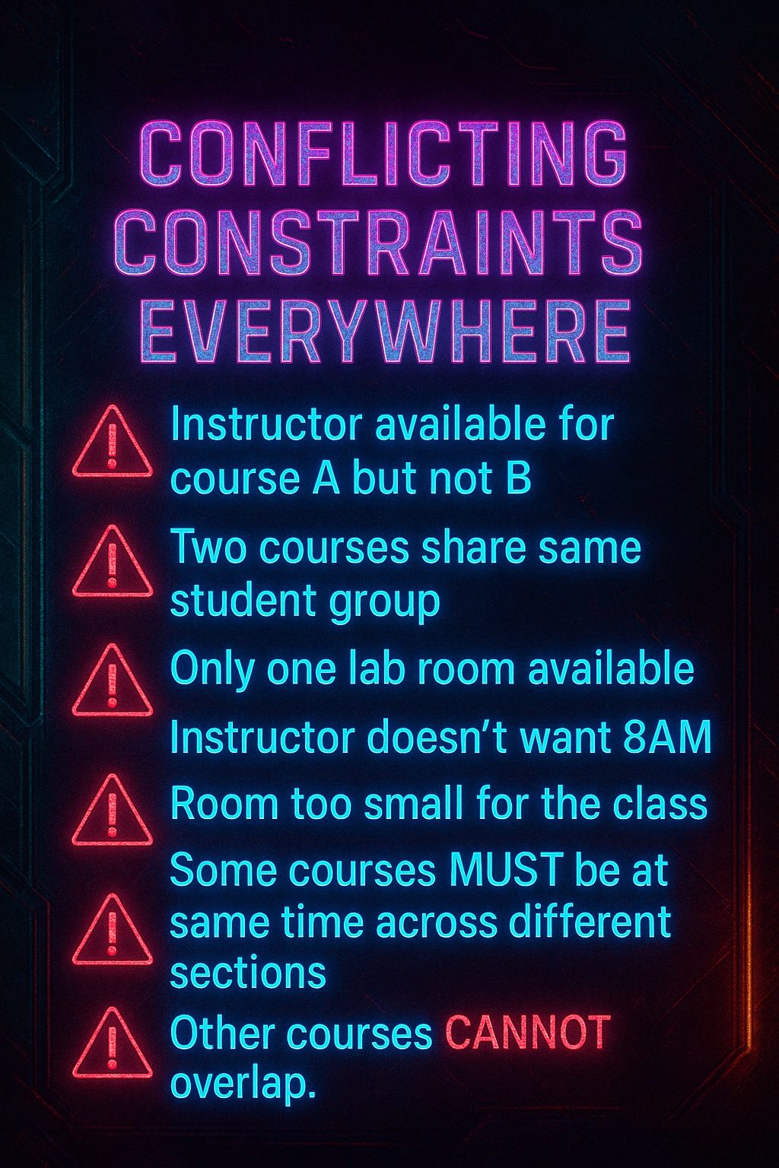
💥 What Actually Makes the Problem Hard? (The REAL pain points)

Slide 6
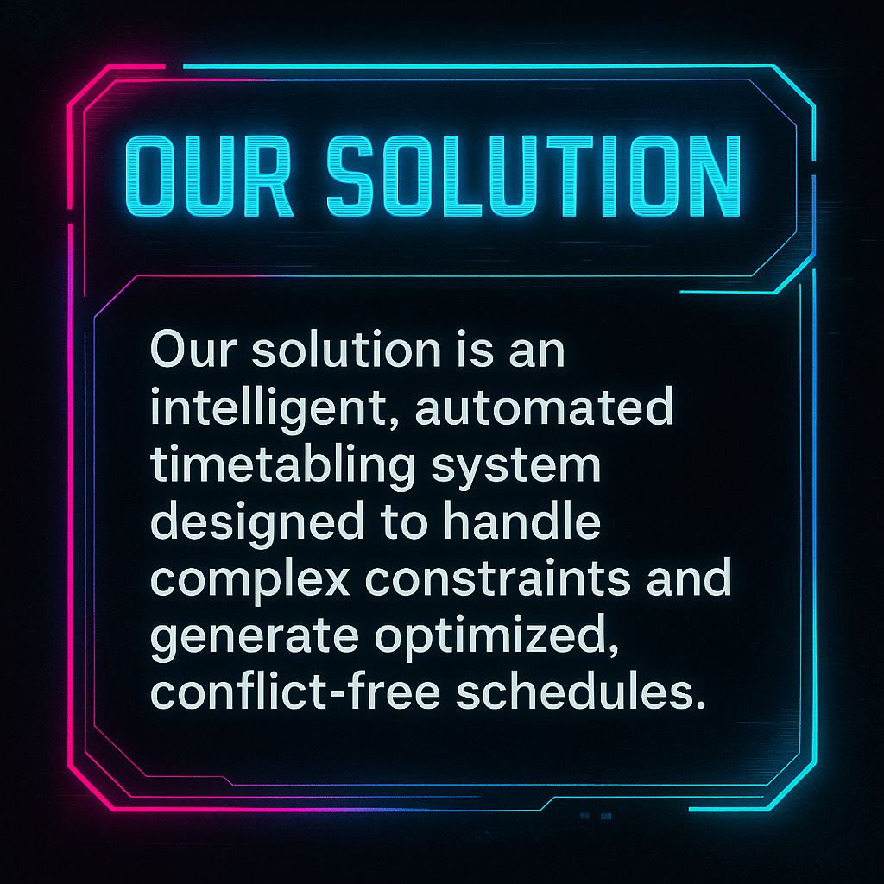

Slide 7
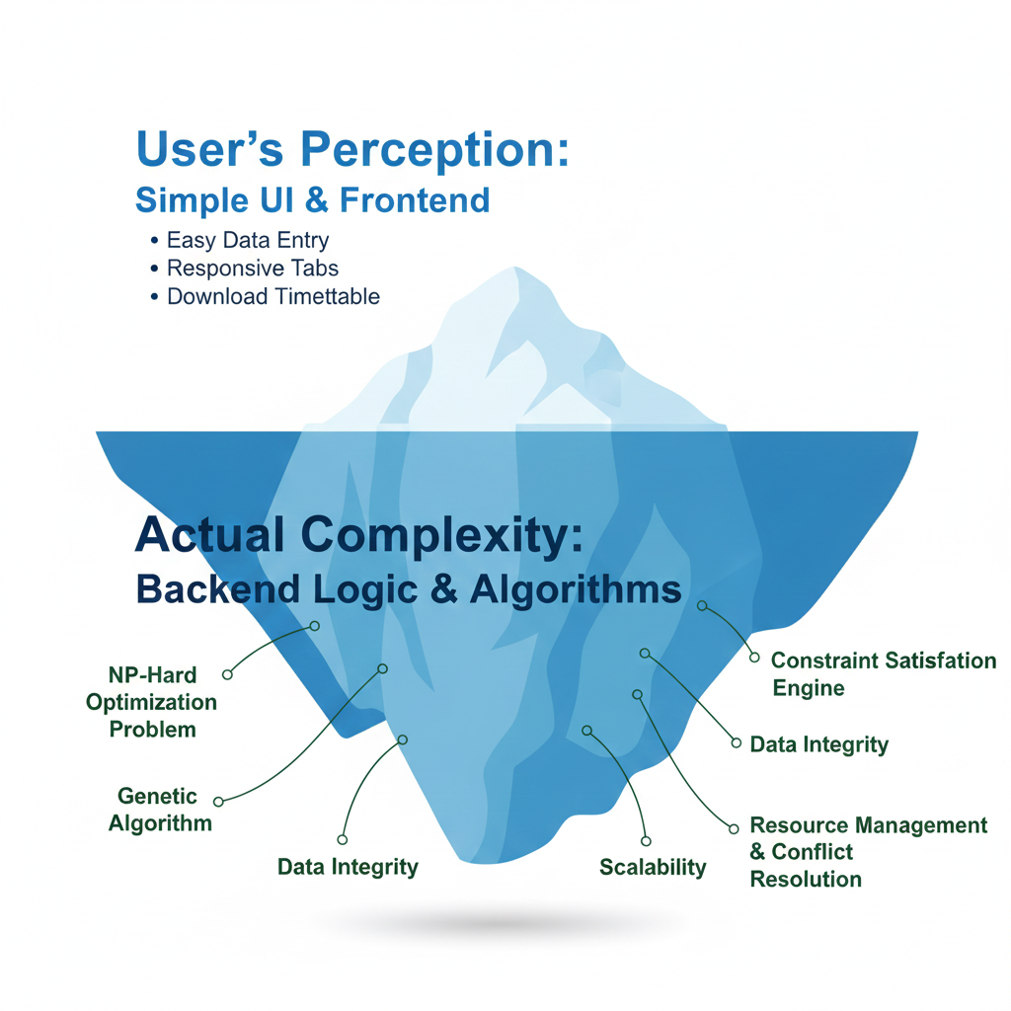
https://pdfs.semanticscholar.org/8cc1/0d0845db327726f5bd8abe1d29dce745c3c7.pdf

Slide 8


01
University Course Timetabling System

Slide 9



Automated scheduling using genetics
Genetic Algorithm Basics
Evolutionary approach mimicking natural selection to solve complex scheduling problems through iterative optimization.
Chromosome Structure
Represents potential timetable solutions with encoded course, room, and time slot information.
Population Management
Multiple timetable candidates evolve across generations, with stronger solutions surviving based on fitness scores.
Fitness Evaluation
Measures solution quality by counting constraint violations and optimizing resource allocation.

Slide 10

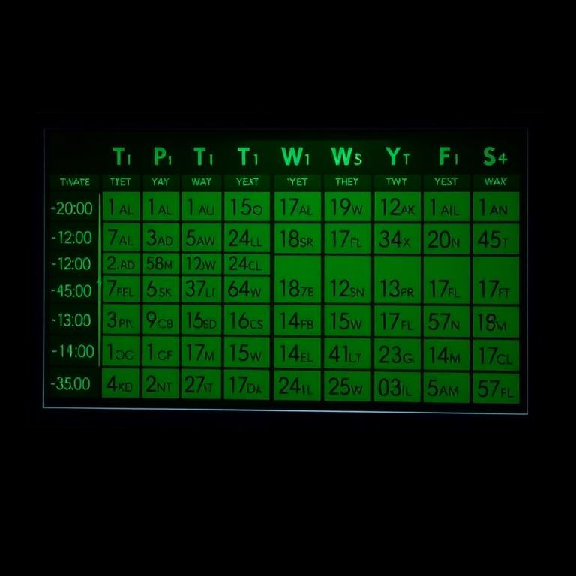


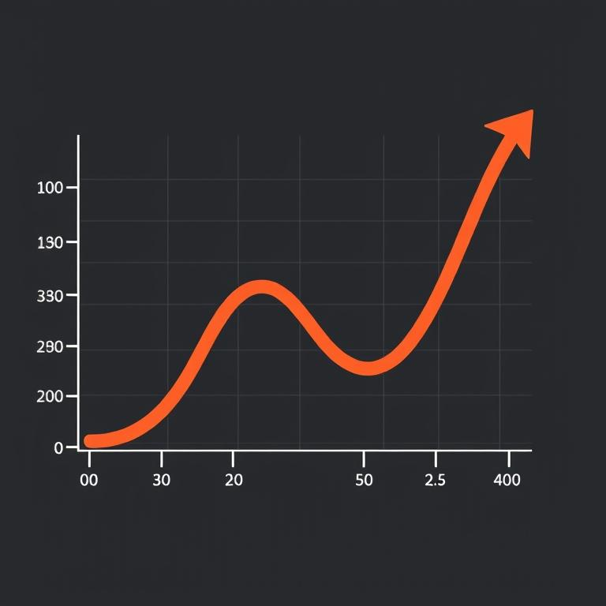
Resource allocation challenge
Conflicting Requirements
NP-Hard Problem
Course schedules must balance instructor availability, student needs, and room suitability without overlaps.
Timetabling requires computational resources that increase exponentially with each additional constraint or course.
01
02
03
04
Limited Resources
Complex Combinations
Universities face constraints with rooms, instructors, and time slots when scheduling over 100 courses.
The large number of variables creates millions of possible timetable arrangements, making manual scheduling impractical.

Slide 11



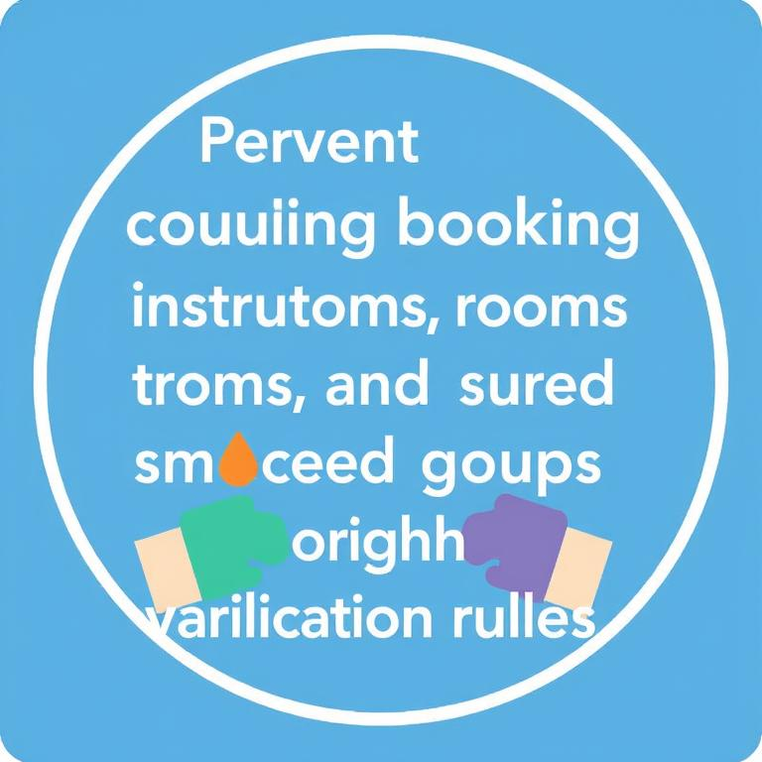


Conflict-free timetable generation
Automatic constraint resolution
Hard constraint enforcement
System intelligently resolves scheduling conflicts between courses, instructors, and rooms without manual intervention.
Prevents double-booking of instructors, rooms, and student groups through strict validation rules.
Optimization algorithm
Common course pairing
Genetic algorithm evaluates thousands of possible schedules to find optimal solutions meeting all requirements.
Special attention to frequently combined courses ensures students can attend all required classes without conflicts.

Slide 12
02
Problem Complexity Analysis

Slide 13
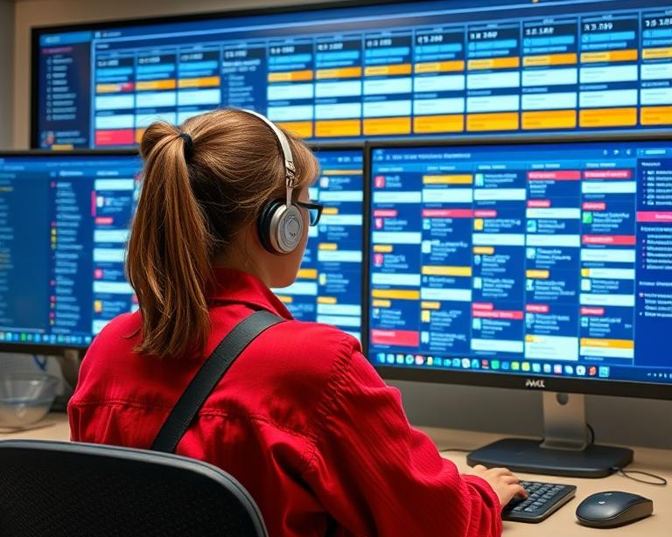
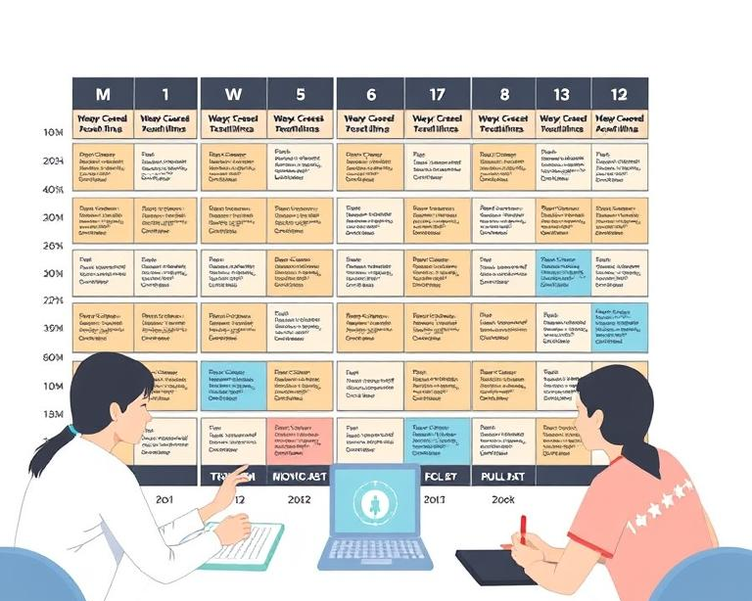


Over 100 courses
Large Course Volume
Scheduling Complexity
Resource Optimization
Conflict Resolution
System handles extensive academic scheduling needs with over 100 courses requiring efficient timetable allocation.
Multiple courses create exponential combinations, making manual scheduling impractical and error-prone without automation.
Algorithm efficiently distributes limited classroom resources across numerous courses while maintaining educational quality standards.
System automatically prevents scheduling conflicts among the extensive course catalog through constraint-based programming.

Slide 14
Limited rooms
Room availability constraints
Capacity challenges
Resource optimization
Room suitability matching
Limited classroom resources create scheduling bottlenecks when allocating spaces for over 100 university courses.
Rooms must accommodate varying class sizes while meeting specific course requirements and technical needs.
System must efficiently distribute limited spaces to maximize utilization without creating conflicts or overcrowding.
Algorithm pairs courses with appropriate rooms based on capacity, equipment needs and location preferences.
·
·
·
·
1
2
3
4

Slide 15
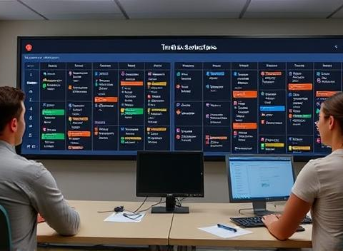

Instructor availability conflicts
Instructor Double-Booking
Conflict Resolution
System prevents instructors from being scheduled in multiple classes simultaneously, ensuring no time conflicts occur.
Algorithm prioritizes instructor availability when generating timetables, minimizing scheduling conflicts through optimization techniques.
Time Preference Handling
Availability Input
Accommodates faculty availability constraints by scheduling courses only during their specified available time slots.
Interface allows instructors to input preferred teaching times, which become constraints in the scheduling algorithm.

Slide 16

Hard constraints never violated
No double-booking instructors
No room conflicts
Instructors cannot be scheduled to teach multiple courses simultaneously, preventing scheduling conflicts.
Each room can only host one class at any given time, ensuring physical space availability.
No student group overlaps
Resource allocation rules
Student groups cannot be scheduled for multiple courses in the same timeslot, preventing attendance conflicts.
All courses must be assigned appropriate rooms and qualified instructors within available timeframes.

Slide 17
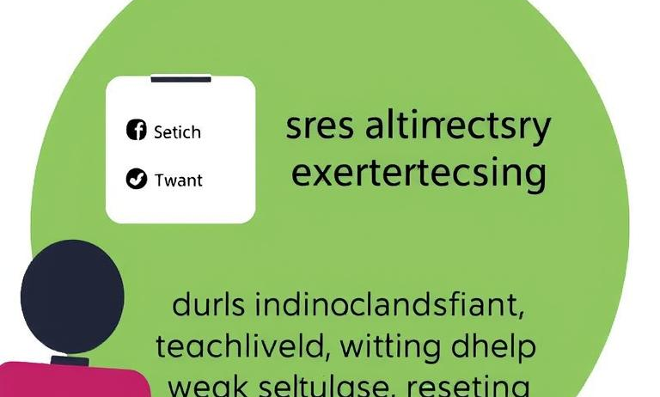

Soft constraints preferences
Instructor preferences
Room suitability
Faculty can specify preferred teaching times and avoid scheduling during personal commitments.
Matches courses with appropriate rooms based on equipment needs, capacity, and teaching style requirements.
Student convenience
Department clustering
Minimizes gaps between classes and avoids late evening sessions when possible.
Groups related courses in nearby locations to reduce travel time between consecutive classes.

Slide 18
03
System Architecture Components

Slide 19
Functional Requirements
Course Data Management
Room Resource Profiling
Complete CRUD operations for course information, enabling efficient administration of academic scheduling data.
Detailed tracking of classroom capacity and features ensures appropriate space allocation for all courses.
Instructor Constraints
Automated Generation
System captures availability preferences and teaching qualifications to optimize instructor scheduling and satisfaction.
Algorithm creates conflict-free timetables automatically, saving administrative time and improving schedule quality.

Slide 20





Course data management
Course Data Fields
Data Entry Interface
Includes course name, code, number, and group/section number for comprehensive course identification and organization.
User-friendly form with validation ensures accurate course information input through the web application.
CRUD Operations
Data Relationships
System supports adding, updating, deleting and viewing course information with intuitive database management controls.
Course data connects with instructor availability and classroom resources to enable effective timetable generation.

Slide 21

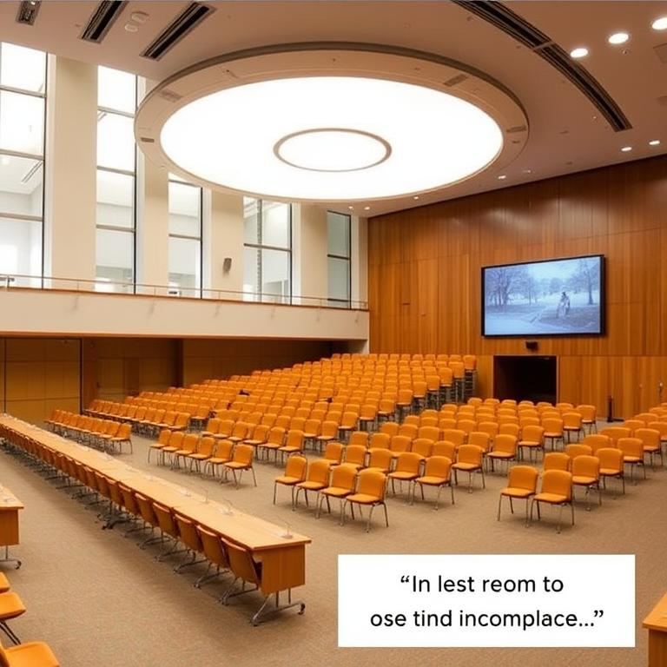


Classroom data management
Room Code Management
Capacity Tracking
Unique identifiers for each classroom, enabling efficient tracking and allocation within the timetabling system.
Records maximum student occupancy for each room, preventing overcrowding and optimizing space utilization.
Room ID System
Room Type Classification
Secondary identification method ensuring rooms are properly categorized and searchable in the database.
Categorizes spaces by function (lecture hall, lab, seminar room), ensuring appropriate course-room matching.

Slide 22



Instructor data management
Instructor Profile Management
Course Assignment
Create and maintain comprehensive instructor profiles with personal details and teaching qualifications.
Link instructors to specific courses based on expertise and teaching capacity.
Availability Tracking
Data Operations
Record preferred teaching hours and unavailable time slots to prevent scheduling conflicts.
Perform add, update, delete and view functions through intuitive interface controls.

Slide 23
CRUD operations support
01
Create Records
02
Read Data
Add new courses, instructors, and rooms to the system database with complete information fields.
View existing timetable information through organized interfaces showing all entered records.
03
Update Information
04
Delete Entries
Modify existing course details, instructor preferences, and room specifications as requirements change.
Remove outdated or incorrect records from the system while maintaining database integrity.

Slide 24

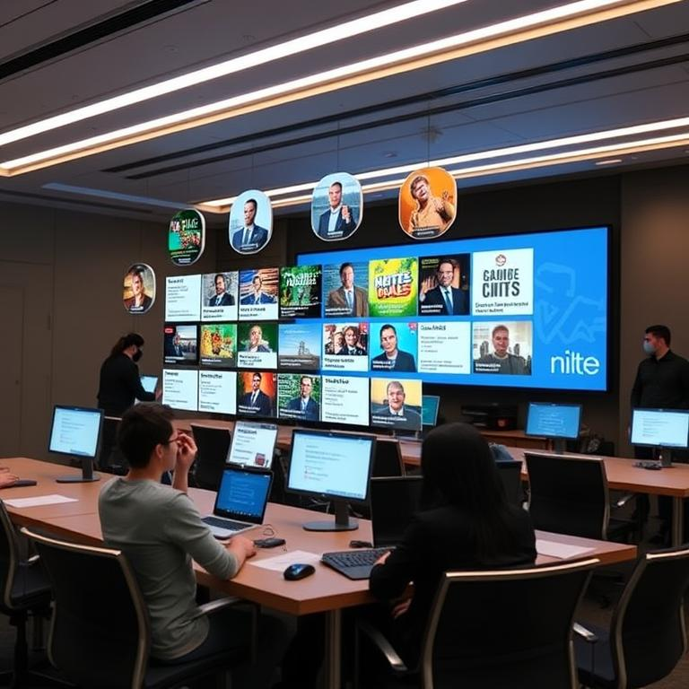


Timetable generation function
Constraint Handling
Output Format
Algorithm respects hard constraints while optimizing soft constraints to create conflict-free schedules.
Timetable displays each course with assigned time, room, and instructor information in organized rows.
01
02
03
04
Automated Schedule Generation
Course Distribution
System produces optimized timetables automatically when user clicks Generate button after data entry.
System intelligently distributes over 100 courses across available time slots and rooms.

Slide 25
04
Data Structure Design

Slide 26

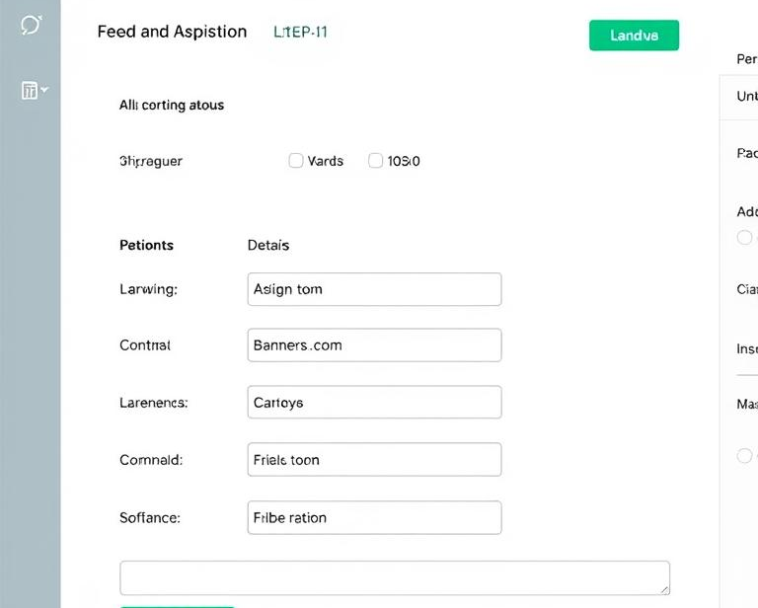
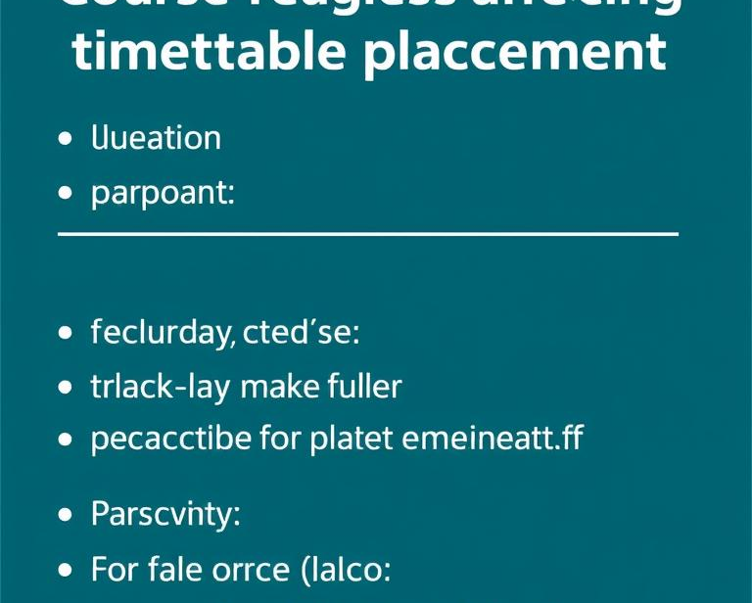

Course name and code
1
2
3
4
Course Information Fields
Data Entry Form
Scheduling Parameters
Instructor Assignment
Essential data including name, code, number and group/section identifiers for effective course management.
Structured input interface capturing all course details with validation to ensure complete information.
Course-specific requirements affecting timetable placement including duration, frequency and prerequisite relationships.
Links courses to qualified instructors while respecting teaching load limits and specialization areas.

Slide 27

Room code and capacity
Room identification system
Capacity constraints
Unique codes assigned to each classroom for efficient tracking and management in the timetabling system.
Maximum student numbers per room, critical for appropriate course-to-room assignment and preventing overcrowding.
Room type classification
Data management
Categorization by facilities and equipment to match specific course requirements and teaching methodologies.
CRUD operations for room information, allowing administrators to maintain accurate and current facility records.

Slide 28




Instructor availability slots
Time slot management
Preference recording
Constraint integration
Visualization tools
Instructors input available teaching hours, creating foundation for conflict-free scheduling.
System captures preferred teaching periods, optimizing instructor satisfaction while meeting institutional requirements.
Availability data becomes hard constraints, preventing algorithm from scheduling courses during unavailable times.
Calendar interfaces display instructor commitments clearly, facilitating efficient data entry and verification.

Slide 29

Time allocation parameters
Course Duration Settings
Instructor Availability Windows
Define standard lecture lengths and lab sessions to ensure consistent scheduling across departments.
Faculty members input preferred teaching hours and unavailable periods to optimize instructor satisfaction.
02
03
04
01
Room Transition Buffers
Academic Day Structure
Allocate time between classes for room changes, equipment setup, and student movement between buildings.
Configure start/end times and break periods to align with institutional policies and student learning patterns.

Slide 30
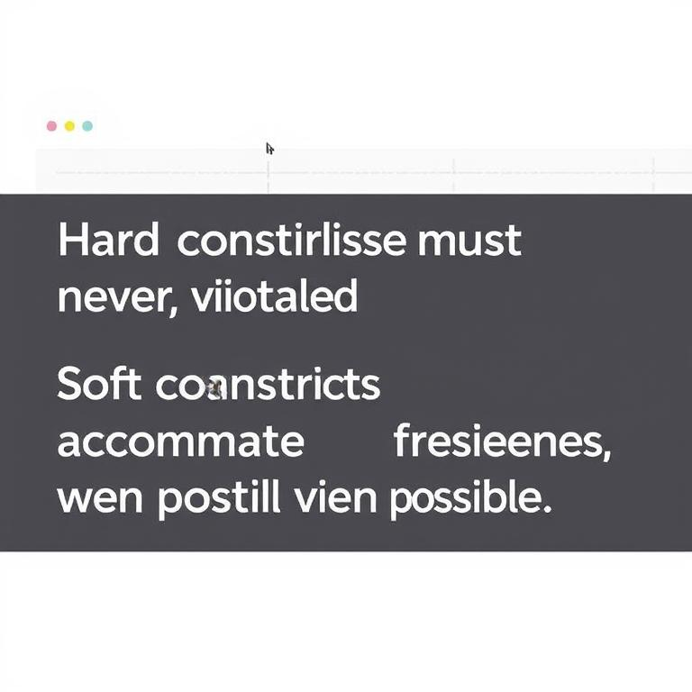
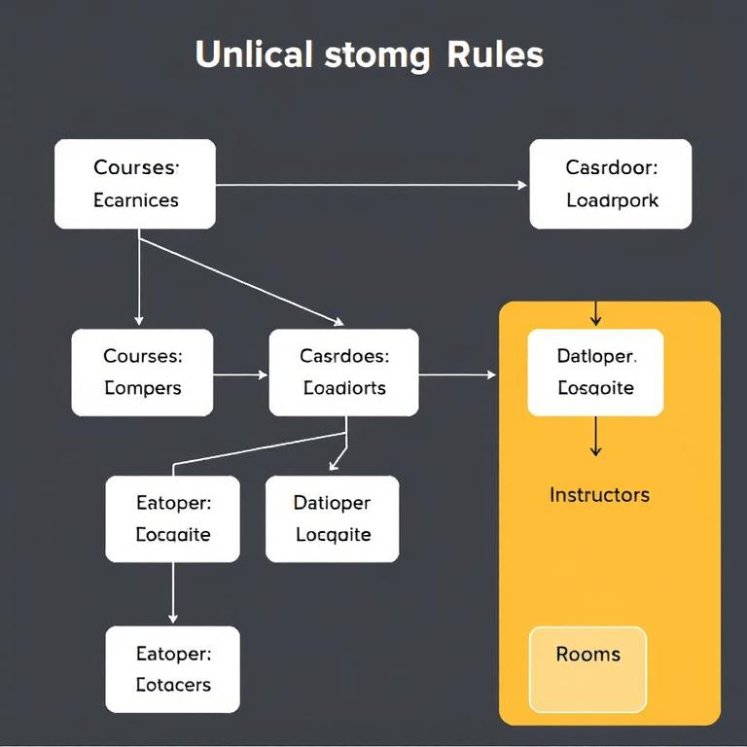

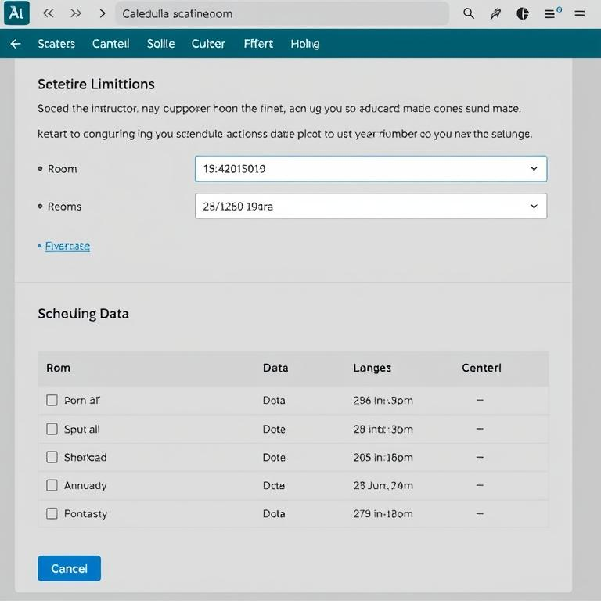
Constraint relationship mapping
Hard vs. Soft Constraints
Constraint Visualization
Hard constraints must never be violated, while soft constraints accommodate preferences when possible.
Visual representation of scheduling rules showing relationships between courses, instructors, rooms and time slots.
Conflict Resolution
Constraint Input Methods
System prioritizes constraints to resolve competing requirements when generating optimal timetable solutions.
Web interface allows detailed entry of scheduling limitations through dedicated instructor and room data pages.

Slide 31
05
Genetic Algorithm Implementation

Slide 32
Crossover and mutation
01
02
Genetic Recombination Process
Random Genetic Changes
Combines parent solutions to create offspring timetables, preserving beneficial scheduling patterns while exploring new possibilities.
Introduces diversity by randomly altering course assignments, preventing algorithm stagnation and escaping local optimization traps.
03
04
Optimization Balance
Selection Mechanisms
Balances exploration of new solutions with exploitation of known good patterns to find optimal university timetables.
Prioritizes fitter timetable solutions with fewer constraint violations for breeding the next generation of scheduling options.

Slide 33
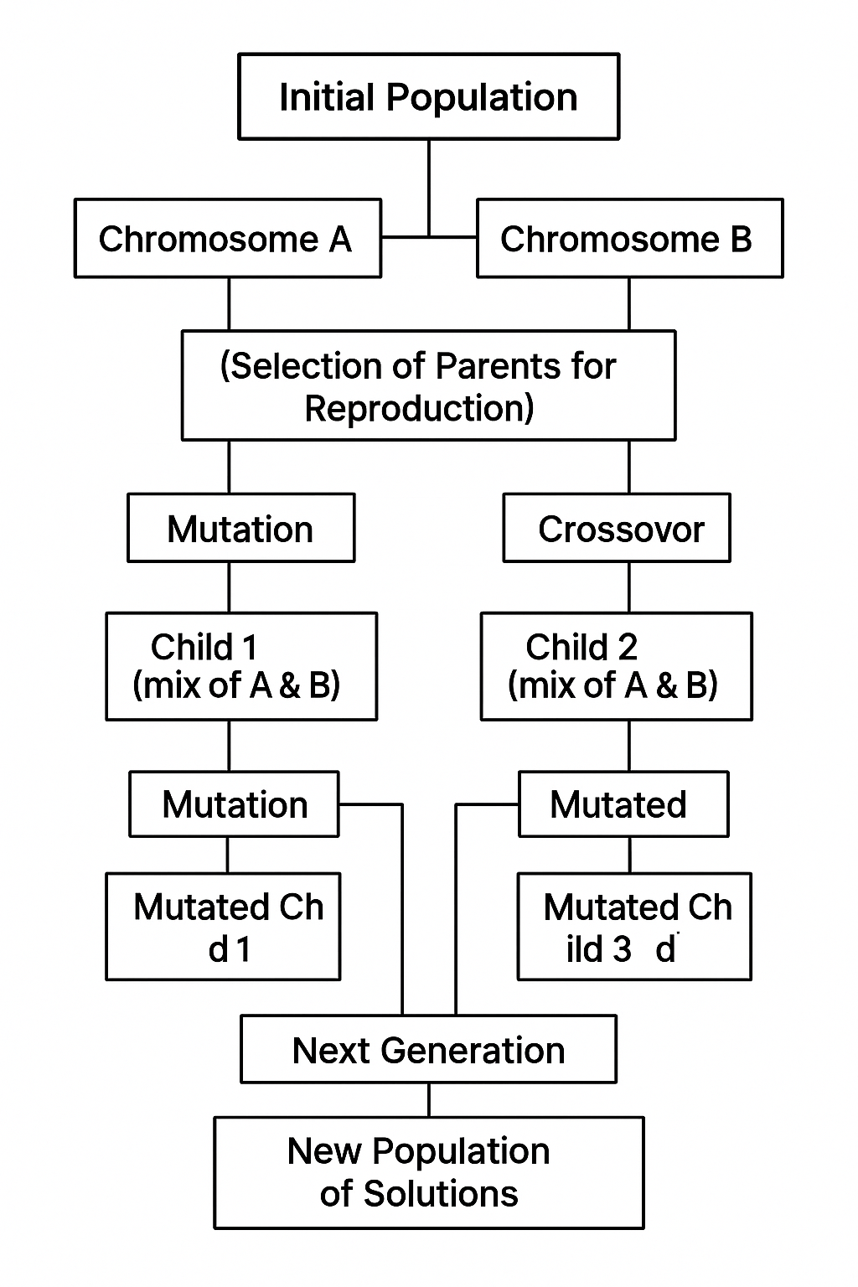
Parents and children Idea in Genetic algo

Slide 34
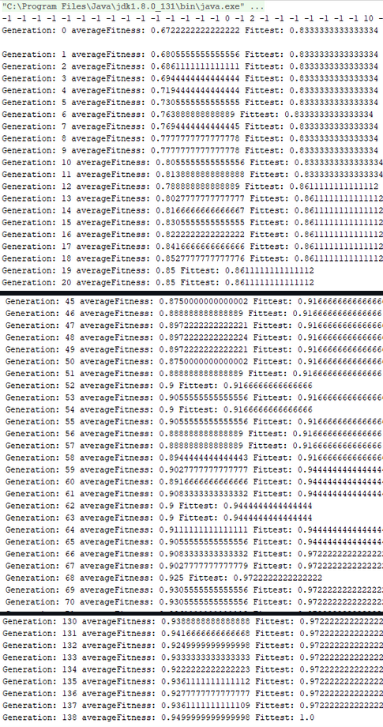
we want the correctness to be as high as possible.

Slide 35
06
System Benefits

Slide 36
Adaptability for future semesters
Semester-to-semester flexibility
Constraint modification
System easily accommodates changing course offerings, instructors, and room availability between academic terms.
Users can update constraints and preferences as institutional requirements evolve over time.
Scalable architecture
Data persistence
Handles growing course catalogs and increasing complexity without performance degradation.
Previous semester configurations can be saved as templates for future scheduling cycles.

Slide 37




Efficient scheduling process
One-click scheduling system produces optimized timetables respecting all constraints automatically.
Automated Timetable Generation
System handles both hard constraints (room conflicts) and soft constraints (instructor preferences) for conflict-free scheduling.
Constraint Management
User-friendly web forms capture course, classroom, and instructor information through intuitive CRUD operations.
Data Entry Interface
Advanced evolutionary algorithm evaluates fitness, performs crossover and mutation to find optimal scheduling solutions.
Genetic Algorithm Solution

Slide 38

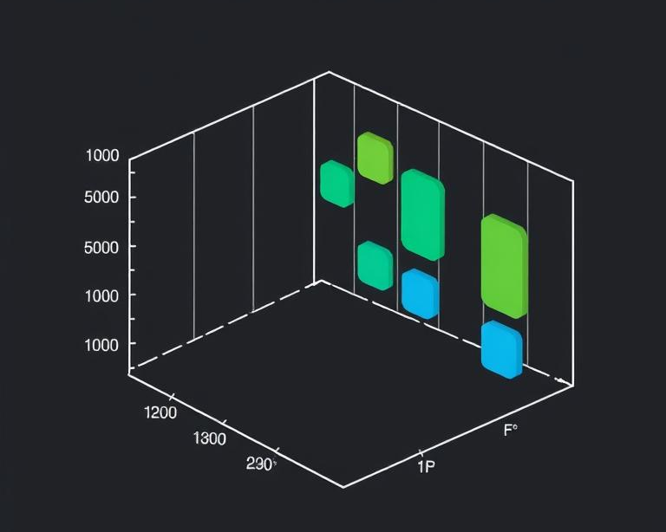
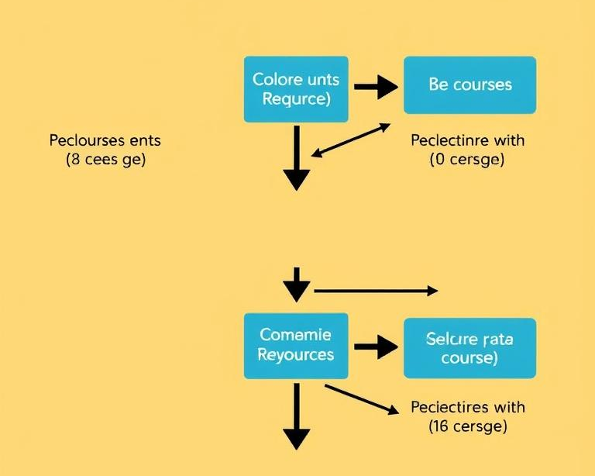

Automatic constraint handling
Automatic constraint enforcement
Preference accommodation
Conflict resolution
Optimization process
System prevents double-booking of instructors, rooms, and student groups through intelligent scheduling algorithms.
Soft constraints like instructor preferences and room suitability are optimized while maintaining schedule integrity.
Algorithm automatically identifies and resolves scheduling conflicts for commonly paired courses and limited resources.
Genetic algorithm evaluates fitness of potential schedules, evolving solutions until optimal timetable is achieved.

Slide 39
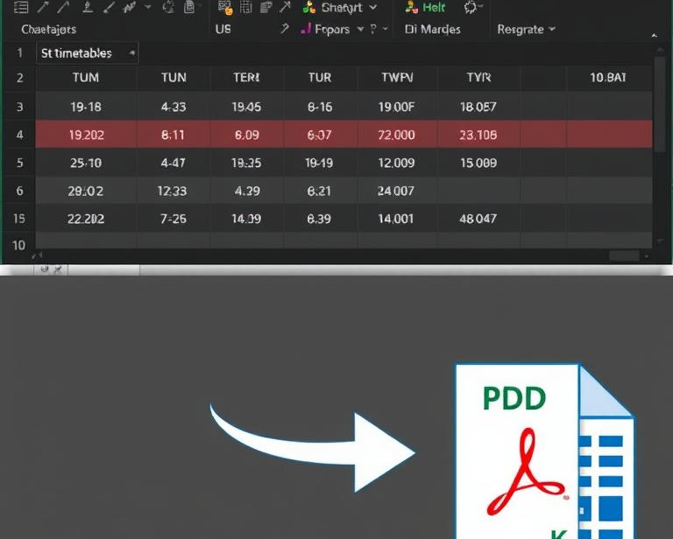
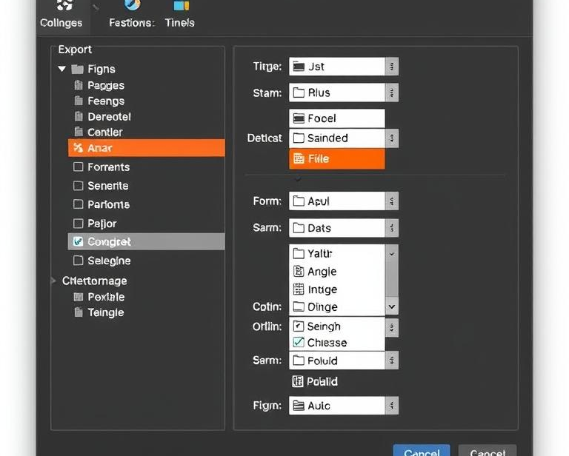
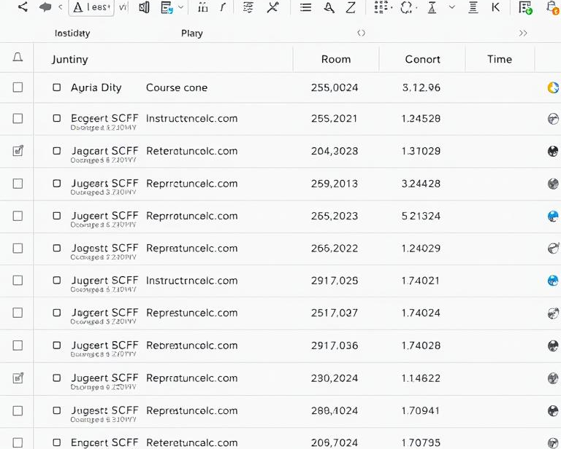
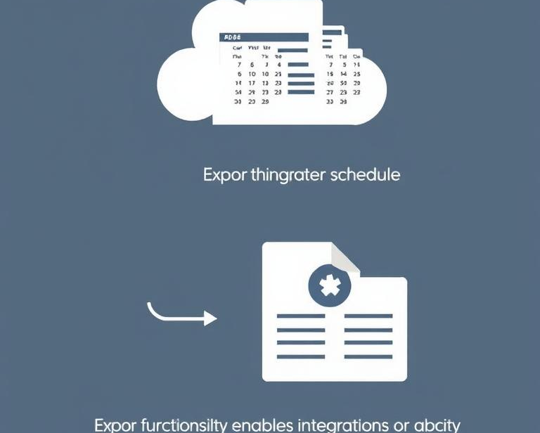
Multiple export formats
1
2
3
4
Excel and PDF formats
Customizable outputs
Print-ready documents
Data portability
Generated timetables can be exported to Excel spreadsheets or PDF documents for easy sharing and printing.
Users can select specific data fields and formatting options when exporting timetables to different file formats.
Exported files maintain professional formatting with course codes, room assignments, instructor names and time slots clearly displayed.
Export functionality enables integration with other university systems and allows stakeholders to access schedules without system login.

Slide 40
Thanks！

